Slide 1
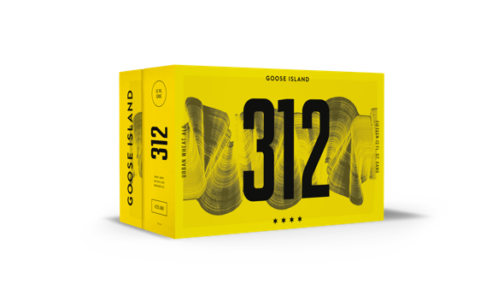
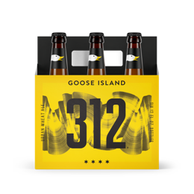
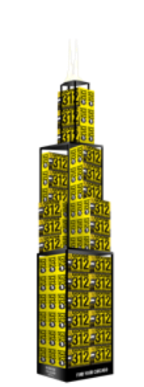
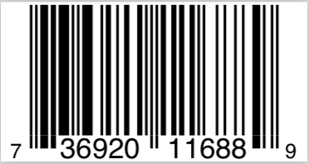
STR | Available Now
MARKET | Nationwide
AVAILABILITY | Year-Round
PACKS | 25oz Can 4pk 16oz Can 6pk 12oz Can & Bottle 12pk Bottle 15pk Can 1/2 BBL 1/6 BBL
STYLE | Urban Wheat Ale
ABV | 4.2%
IBU | 18
HOPS | First Gold, Mt. Hood, Cascade
MALTS | 2-Row, White Wheat
312 URBAN WHEAT ALE
T1 MARKETING MOMENTS
TRADE SUPPORT
Inspired by the city of Chicago and densely populated with flavor, 312’s spicy aroma of Cascade hops is followed by a crisp, fruity ale flavor delivered in a smooth, creamy body that’s immensely refreshing.
In Chicago, March 12th means it is 312 day, the official city-wide holiday where fans of good beer get to celebrate. In 2019, 312 will expand from our home city to key markets across the country. A POCM toolkit will deliver BOMs, concerts, and off-premise displays.
Full 360 Campaign Support
6-PACK BOTTLE
6-PACK CAN
12-PACK BOTTLE
24/12oz MASTER
15/25oz CAN
15-PACK 12oz CAN
4-PACK 16oz CAN
1/2 BARREL
1/6 BARREL
GAX 113YA86
GAX 113Y034
GAX 113YA82
GAX 113YA82
GAX 113Y251
GAX 113Y7H5
GAX 113Y044
GAX 113Y940
GAX 113Y970

