Slide 1
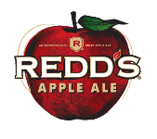
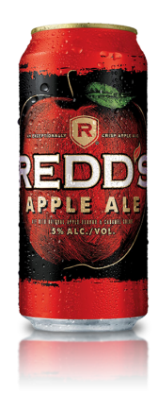
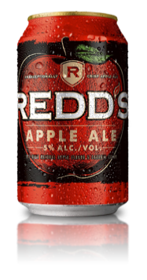
Information
Product Information: 5% ABV Flavored Ale; 165 calories per 12oz. REDD’S® is an ale, not a cider. A cider is made using fermented apple juice (similar to wine). Ales are brewed.
Aatmf
Appearance: | A deep golden hue with light carbonation.
Aroma: | A fresh, pleasant apple scent.
Taste & Mouthfeel: | This gives it a crisp clean finish and allows for the natural apple flavor to come through for a sweet, tart and refreshing taste.
Finish: | A crisp clean finish for smooth refreshment.

