Slide 1
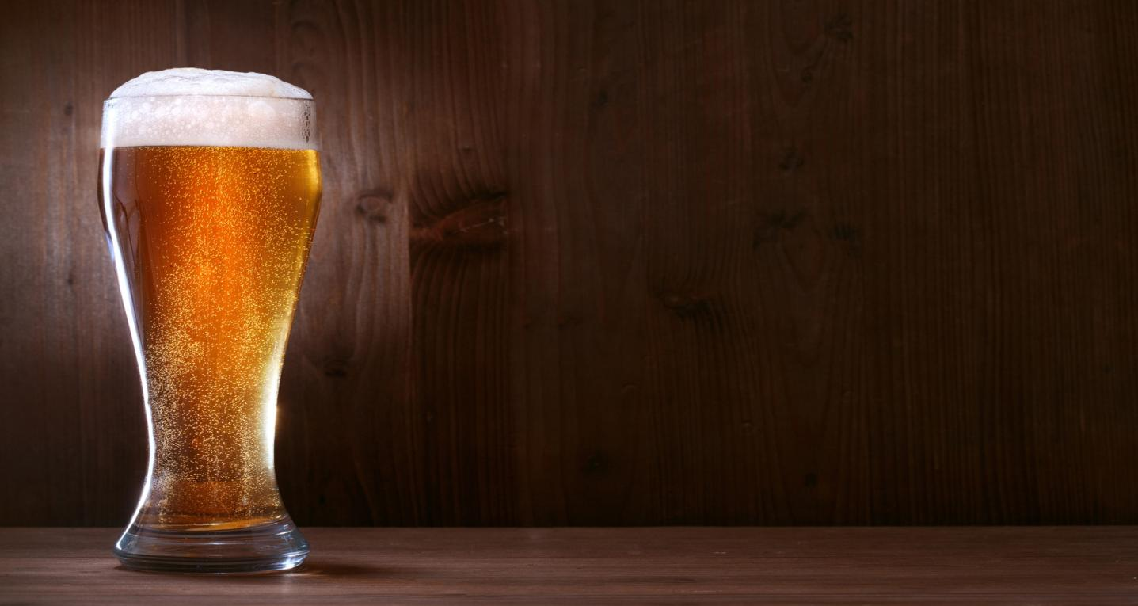

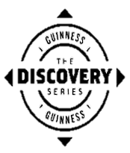
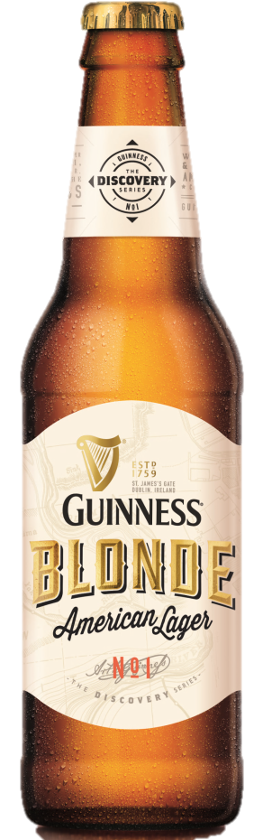
INTRODUCING
GUINNESS® BLONDE AMERICAN LAGER
Launching September 2014 Off Premise Distribution
OPPORTUNITY: DELIGHT MORE ‘BETTER BEER’ DRINKERS WITH A UNIQUE BEER FROM A TRUSTED, HIGH QUALITY BRAND
Today’s consumers are looking for more when it comes to beer; variety is a driving factor in purchase decisions and while 86% of consumers seek ‘clean, crisp taste’ when choosing a beer⁴, they prefer brands with high quality taste credentials^{1,4}.
Guinness is consistently ranked highest as a beer of substance, distinction and authenticity². A brand with real growth opportunity in the Discovery Beer* Segment
INTRODUCING the ‘Discovery Series’ from GUINNESS; a range of ‘fusion brew’ beers combining over 255 years of brewing expertise with experience in 48 countries in order to bring beers with more style and flavor specifically to the US Discovery Beer Drinker.
BEER #1: GUINNESS BLONDE AMERICAN LAGER
A light, crisp & refreshing tasting amber beer with a floral, hoppy aroma. Brewed with Mosaic & Willamette hops and the world famous 125yr old Guinness yeast from the famous St. James Gate Brewery. Guinness Blonde is a crisp, yet complex & flavorful lager with some pale ale characteristics, perfectly balanced with speciality malt to deliver a golden amber color beer.
Twice as smooth, half as bitter and 80% lighter in color than Guinness Draught –
Guinness Artistry & Brewing Tradition -
KEY BENEFITS
Drive Mass Appeal and Higher Profits
2x Greater Brand Strength vs. Major Domestic Brands²
Craft Beer Buyers Who Buy Guinness Spend More⁵
  Brand Strength Rating
  Category Spend Per Household – 52 Wks³
80% More
Guinness Artistry & Brewing Tradition
1. Consumer Edge Insight May 2013 2. Millward Brown Beer Brand Tracking 2012/2013 3. Guestmetrics 2011 4. Mintel Craft Beer US November 2012 5. National Retailer Shopper Card Data 2014

Slide 2

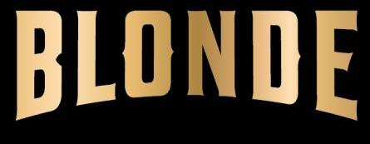

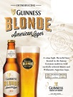
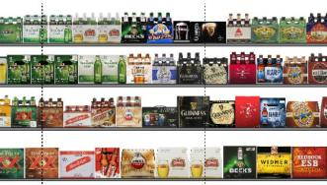
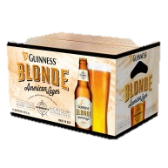
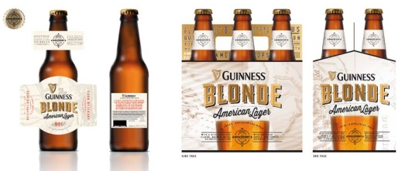
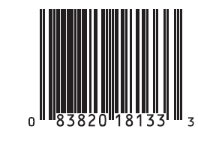


The 360º Support –
$8mm National Launch Driving Over 300MM Impressions
TV
PR
$3mm 8 week intensive launch from mid Oct
Consumer & trade Advocacy Program. Brewmaster dinner Series, in 11 cities nationally
Events
Visibility
American Lager
POS Kits by Channel type for On Premise and Off Premise
Sampling Events Off Premise and On Premise
Digital
Trade Print
Print
$1.5mm Trade mark Digital push with “tease” pre-launch and heavy digital up-weight as complement to TV .
Playboy Tease in July-Aug issue
Reveal in Sept
Female Print Magazines in Oct/Nov
RETAIL STRATEGY
SHELF PLACEMENT & FLOW
Lead with Guinness Blonde adjacent to Mass Imports
Flow left to Right: Blonde, GBL, GDIC, GDIB, GES
DISPLAY
Standalone Blonde Displays During Launch
VISIBILITY
POS
Mass Display Piece
Standalone Displays to Maximize Launch
SKUs
ABV: 5%
Package: 6pk 12oz. Bottle
SRP $8.99 parity to GDIB
12oz.Bottle
12oz. 6pk Carrier
Shipper
NEXT STEPS
Shelf: Recommend Guinness Blonde American Lager distribution within the Small Import Section next to Mass Imports
Display: Execute standalone Mass Displays during launch with educational POS
PLEASE DRINK RESPONSIBILITY
GUINNESS Blonde American Lager ©2014 Guinness & Co. DIAGEO - Guinness USA, Norwalk, CT

